Slide 1


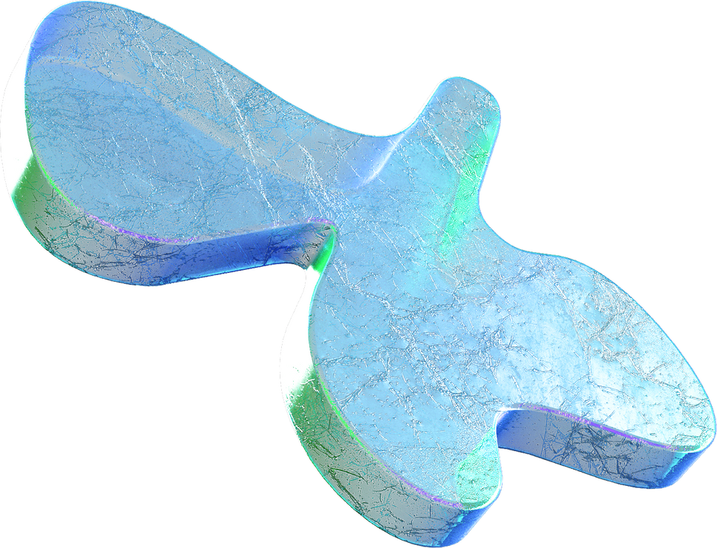
Machine Learning
Day 4

Slide 2

What is kernel, convolution?
More on convolution.
What are pooling layers?
What are dropout layers?
RNNs, more layer types.
Transformer models and attention layers
Agenda
What you’ll know.

Slide 3

What is a kernel/filter?
A kernel is a small matrix, often square, typically much smaller than the image itself.
It contains a set of weights that are used in the convolution process.

Slide 4
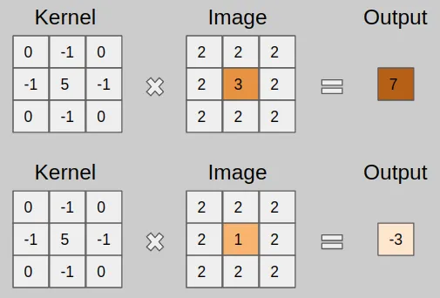

Slide 5
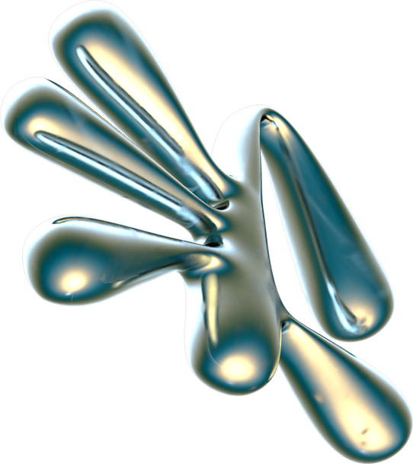
How changing kernel affects output

Slide 6
Types of kernel and their output
Edge Detection |  | Blurring / Smoothing |  | Sharpening |  | Custom Kernels |  | Pooling Layers
Sobel |  | Gaussian |  | Laplacian |  | Others |  | Technically not a kernel
Highlights areas in the image where there is a rapid change in intensity |  | Gives more importance to the center pixel and less to the surrounding pixels |  | Enhances edges and highlights regions where there is a sudden change in intensity |  | To emphasize specific patterns or features of your own choice |  | They down sample image by taking average value in a window.

Slide 7
Pooling Layers
Dropout Layers
Often used in image recognition and computer vision tasks.
They help reduce the spatial dimensions (width and height) of the feature maps produced by convolutional layers.
It is a regularization technique used in deep learning and neural networks to prevent overfitting.
It involves randomly "dropping out" (i.e., setting to zero) a fraction of the neurons in a layer during training.

Slide 8
RNNs
Recurrent Neural Networks
Type of neural network architecture designed to handle sequential data

Slide 9
RECURRENT LAYER
The core layer in an RNN Natural Language Processing, time series analysis, speech recognition, and any task involving sequential or temporal data.
LSTM
An extension of the basic RNN layer. Machine translation, sentiment analysis, and handwriting recognition
GRU
Similar to LSTM but with a simplified architecture and more efficiency. Similar to LSTM, useful in tasks with long-term dependencies
Common layers used in RNNs
Recurrent Layer
LSTM
GRU
Bidirectional RNN
1D Convolutional Layer
Dropout Layer
Multi-layer

Slide 10
Transformer models and attention layers with a focus on GPT

Slide 11
Transformer Models
Attention Layers
To handle sequential data
To weigh the importance of elements in a sequence
Used for Natural Language Understanding (NLU), machine translation, text generation, and many other NLP tasks.
Not limited to NLP; attention mechanisms have been applied to computer vision, speech recognition, and more.

Slide 12
GPT Models
BERT
Generative Pre-trained Transformer
Bidirectional Encoder Representations from Transformers
They read text from left to right and generate predictions one token at a time, which makes them particularly suitable for tasks where context is crucial.
Designed for pre-training on bidirectional contexts. It learns contextualized word representations by considering both left and right context.

Slide 13
Thank you :)
We hope you learned something new.

